Slide 1
Radix Query Interface

Slide 2
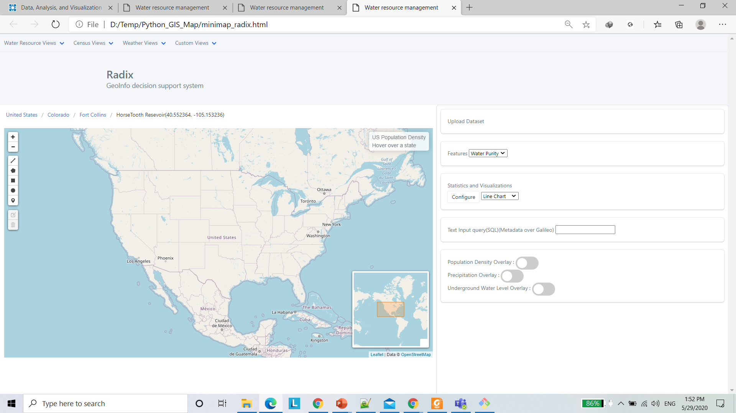
Current Interface

Slide 3
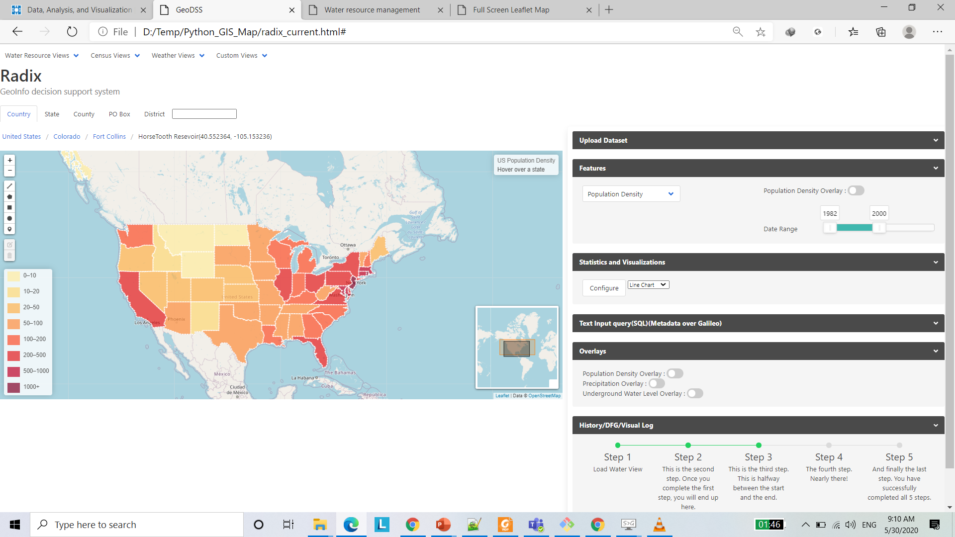
Alterations to interface
2
1
4
3

Slide 4
Display Features
Draw and save polygons over areas of interest(AOI) as views.
Default views per dataset showing features pre-plotted.
Auto-retrieve features related to AOI
Show overlay layer options features detected in 3.
Keep GeoJSON layers of known geographical resolutions ready for discrete features(e.g. census: population density, income) :- State, County, District, Block

Slide 5
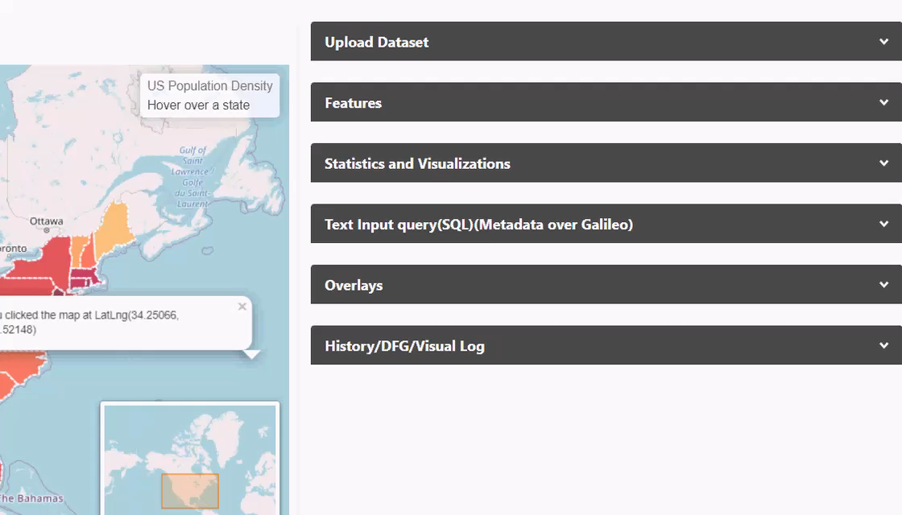
Display changes
Replace section blocks with expandable/collapsible sections(accordions). Makes more space for features.

Slide 6
Interface/UI Improvements
1. Developing the spatiotemporal query interface
- specify the geospatial coverage
- temporal coverage
- auto-detected features
including the feature range
- stat graphs

Slide 7
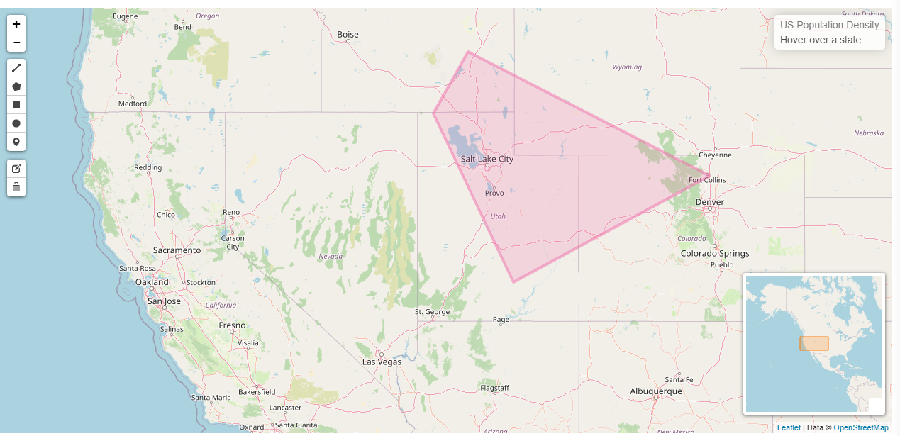
Displaying Geospatial coverage
Idea: Live updating breadcrumb of location/co-ordinates with rough locations.
E.g if the drawn region is between [41.95132, -114.01611] and [40.44695, -105.0293] ->
Utah-Colorado or Salt-Lake City County – Larimer County[Lat]/Idaho Falls – Capital Reef National Park[Long].
Salt-Lake City County – Larimer County[Lat]/Idaho Falls – Capital Reef National Park[Long].
Use place names over numbers because it is more general to view, navigate, understand , and use.
Can make a dropdown list – with this information for each selected polygon

Slide 8
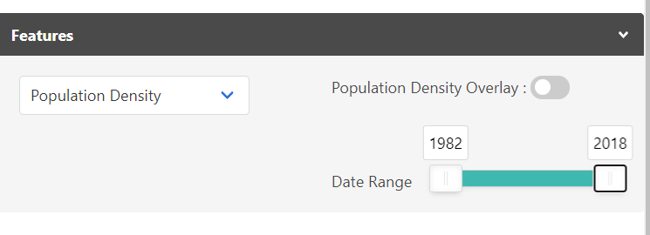
Handling Features
After a polygon layer is loaded or some polygons are drawn on the map, the system auto-detects the features relevant to the area of interest.
Choosing the features to explore the geospatial distribution is the next natural step.
Here there are two tasks that the user must be able to do:
1. Choose feature(s) to see on the map
2. Choose Range for each feature

Slide 9
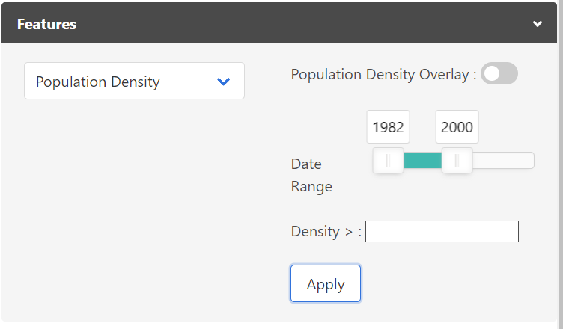
Handling features
List of features and their related overlay options:
Time period: as a slider with two handles: upper and lower
Range of values: as a slider/text input
Identify feature as continuous or discrete, handle each differently.
E.g. Dams in area: Discreet – Keep a layer of marked points ready, options: with - volume > 3000 cubic km
E.g. Continuous: Wind speed – Keep a shaded layer.

Slide 10
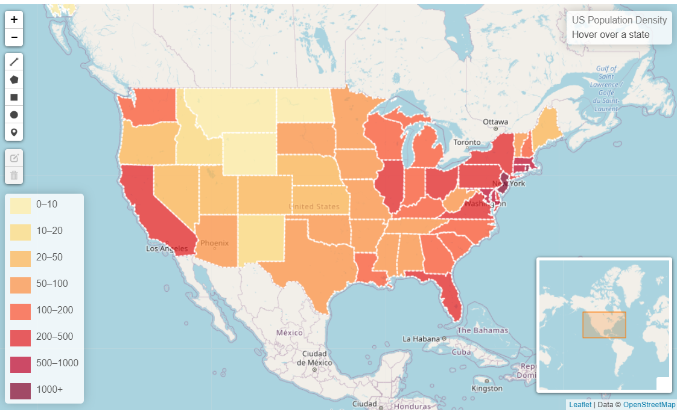
Determining a dynamic range
Note the legend here marked in red:
We calculate these ranges from the data and display a legend like this or accept a range to display in the options like in the previous slide.
We can also try to make this legend interactive(“Click to show/hide layers”)

Slide 11
Temporal coverage
Idea: Input time-period of interest from user: Slider with a lower bound and upper bound slider
Feature specific input? Or stand-alone constraint that applies to all data loaded at that time?

Slide 12
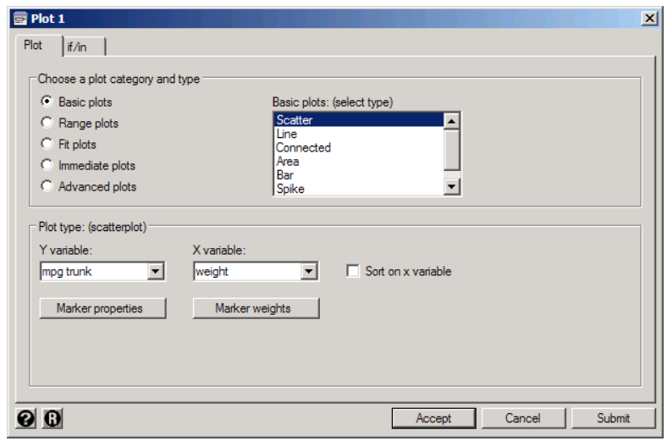
Stat chart
Idea: Popup / collapsible section
Structure: list of plot options
Plot categories
X and y features
Stacked charts -> comma
separated fields. E.g. y variable.
Output: Modal Popup with time sliders to vary data.(polygon – features – graph mapping)
Export image.
Mpg, distance

Slide 13
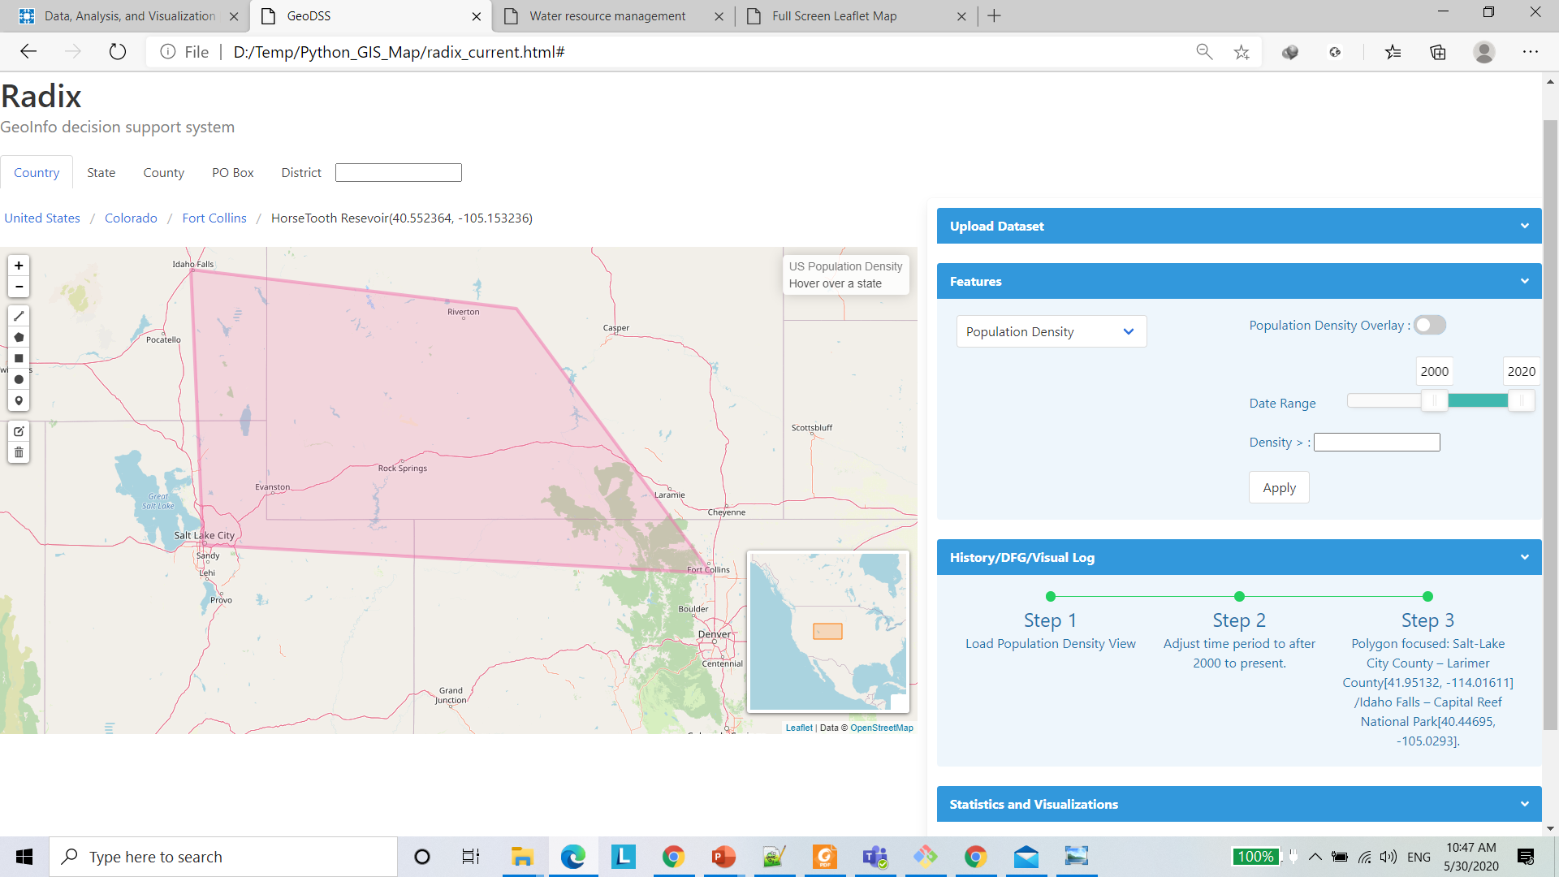
Tracking user query progress

Slide 14
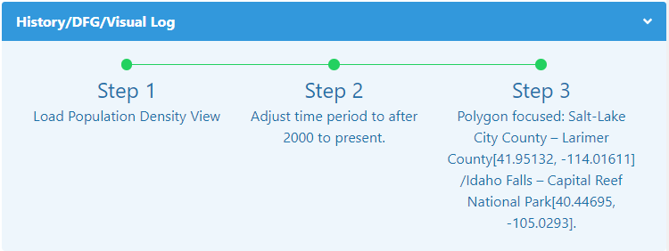
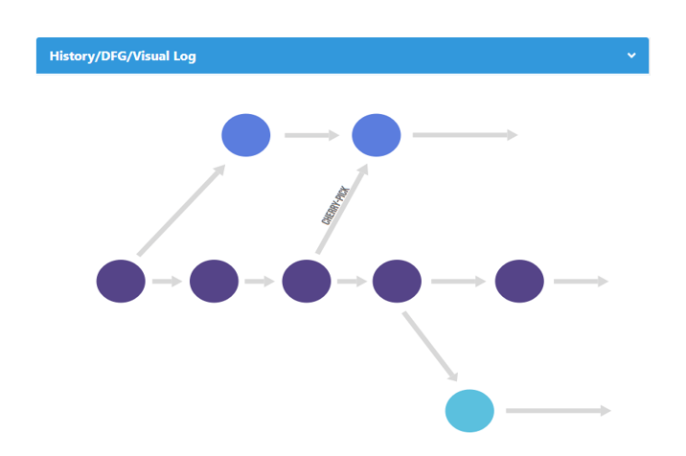
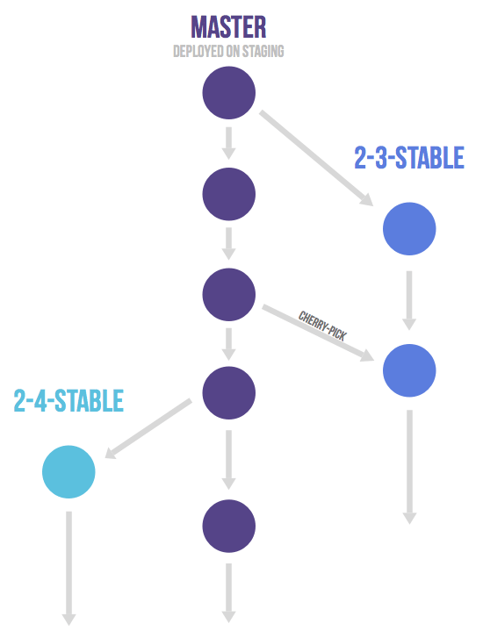
Timeline
- Dynamically add new steps reflecting actions.
Save snapshot of dataframe/RDD after each step.
Allows to step back to that place in time.
Reset button to start again, (save button to save progess)
Allows branching if any changes in history are made.
Like the git commit graph.
Merged Flow Graph

Slide 15
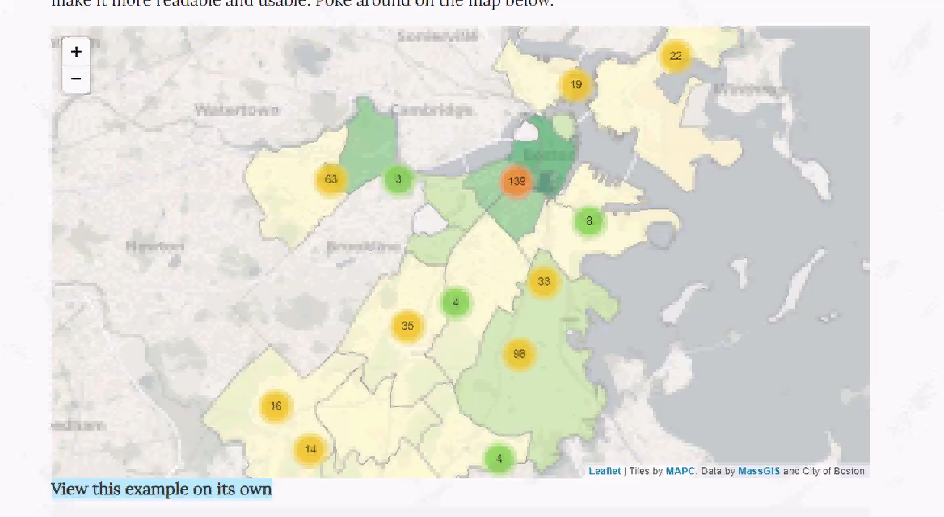
Aggregation Bin plot
We will have to calculate these aggregated values for chosen/correlated features.
Then we can combine each with an icon to display on a minimap of a lower resolution.
Play this video for a demo.
Source: maptimeboston

Slide 16
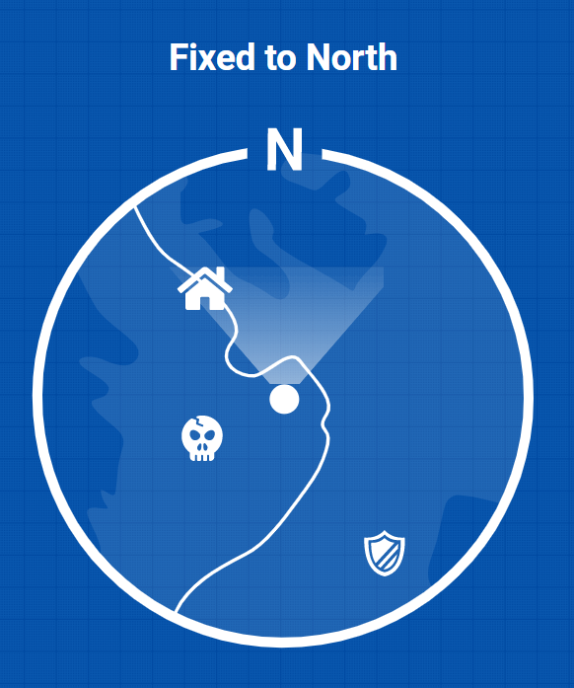
Radar View
To mark the different points of interest.(drops or jumps in correlated values)
First: find the feature with highest relevance(correlation) to current feature.
E.g Arable Land and Water Consumption in Nevada.
Second: Derive a relative scale for the values of the correlated feature in the area.
E.g. Aggregation of County-wise consumption of water in the nearby districts to users area of interest.
Counties around Lake Tahoe, Hoover Dam and the Colorado River may have higher water consumption and areas with potential for conversion to irrigated fields can be discovered
Third: Aggregate the relative measures for surrounding areas visible in minimap.
Fourth: Create Text-Numeric-Symbolic icon to represent the relative measure.
20KL
35KL
50KL
Example for ground-water in surrounding area

Slide 17
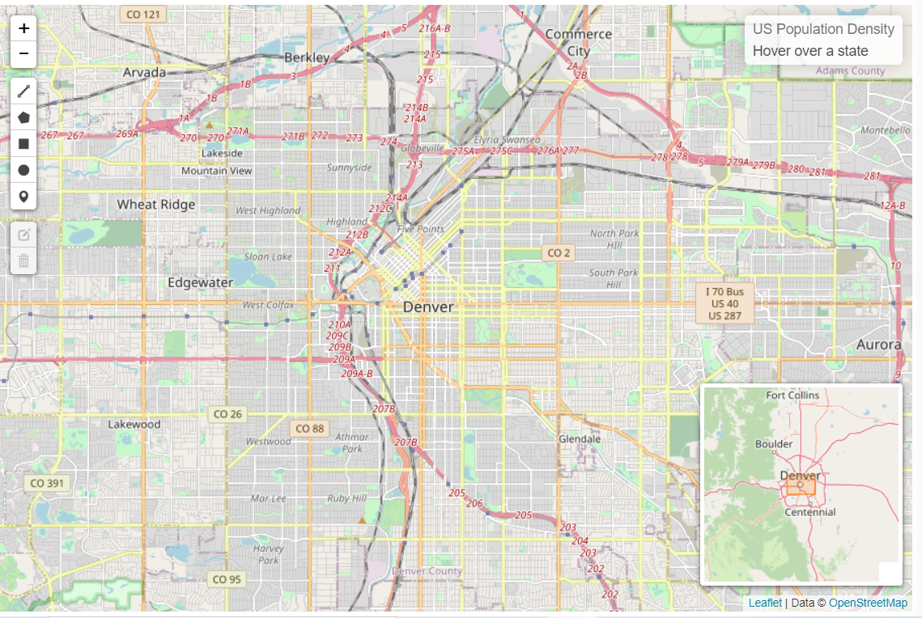
Map level implementation
So far I have made a collapsible minimap. Which can represent layers and markers with popups.

Slide 18
TODO
- Analytics graphs (e.g. correlation matrix, building a linear model, plotting clusters (e.g. k-means, dbscan)
Radar view aggregation demo
Dynamic Updating for timeline

